Slide 1
Indian E-Commerce Analysis and Customer Retention
Prepared By: YALLANTI VENKATA SAI TEJA

Slide 2
Project Introduction
Analyze sales trends
Customer segmentation using RFM
Sales forecasting and business insights
Identify business opportunities
Improve customer retention strategies

Slide 3
Dataset Overview
Customer Data
Product Data
Revenue Data
Geographic Data
Transaction & Sales Information

Slide 4
Data Cleaning & Preprocessing
Removed duplicates
Handled missing values
Converted datetime columns
Prepared clean datasets
Standardized dataset formatting

Slide 5
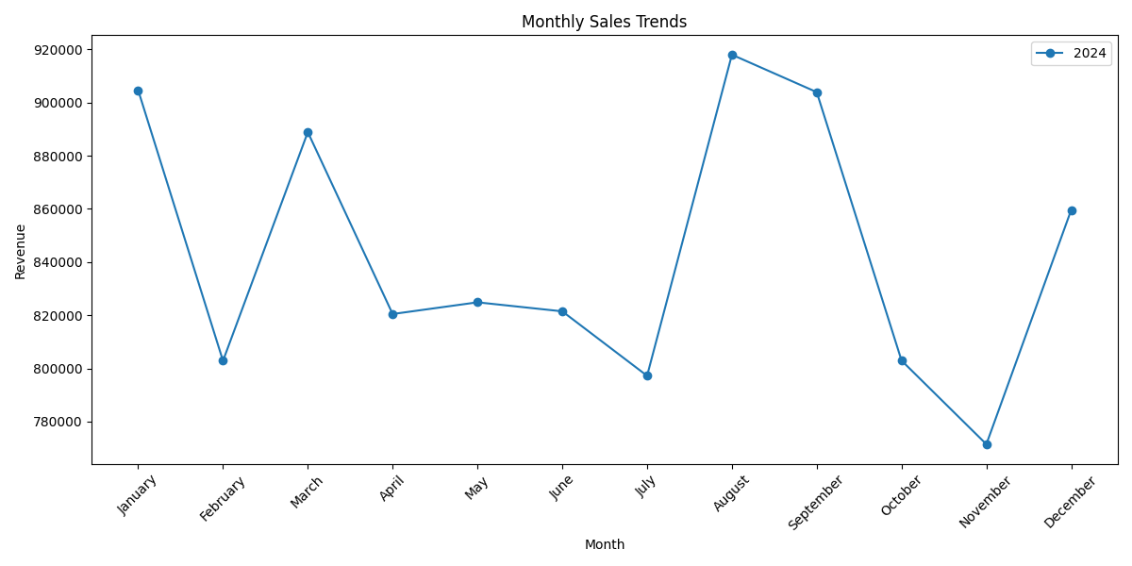
Monthly Sales Trend Analysis
Monthly revenue trends and seasonal sales analysis

Slide 6
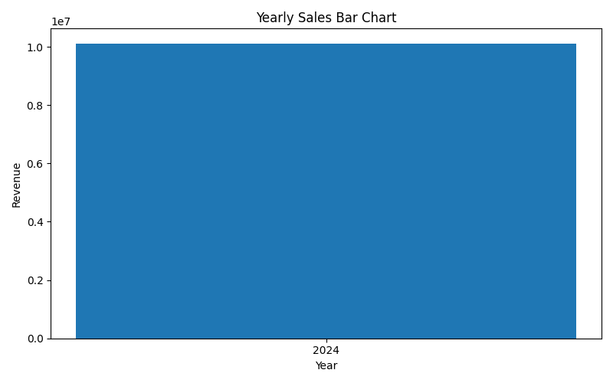
Yearly Sales Performance
Yearly revenue and business growth overview

Slide 7
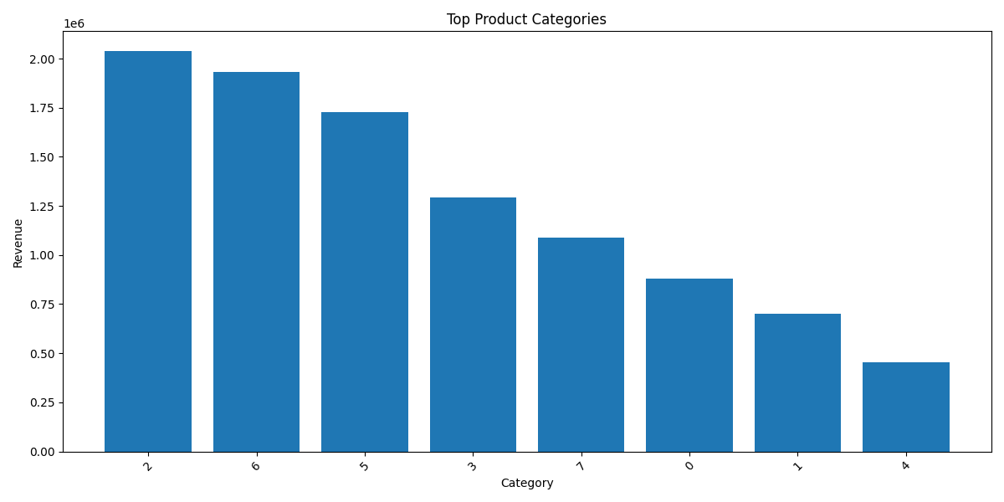
Best-Selling Products & Categories
Top-performing products and categories

Slide 8
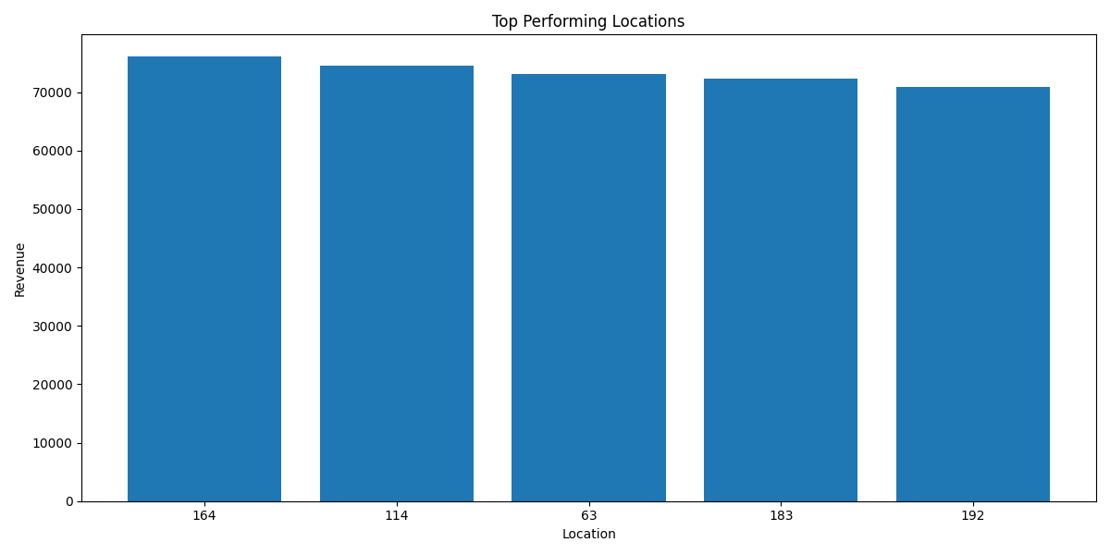
Geographic Sales Performance
Regional sales distribution and location analysis

Slide 9
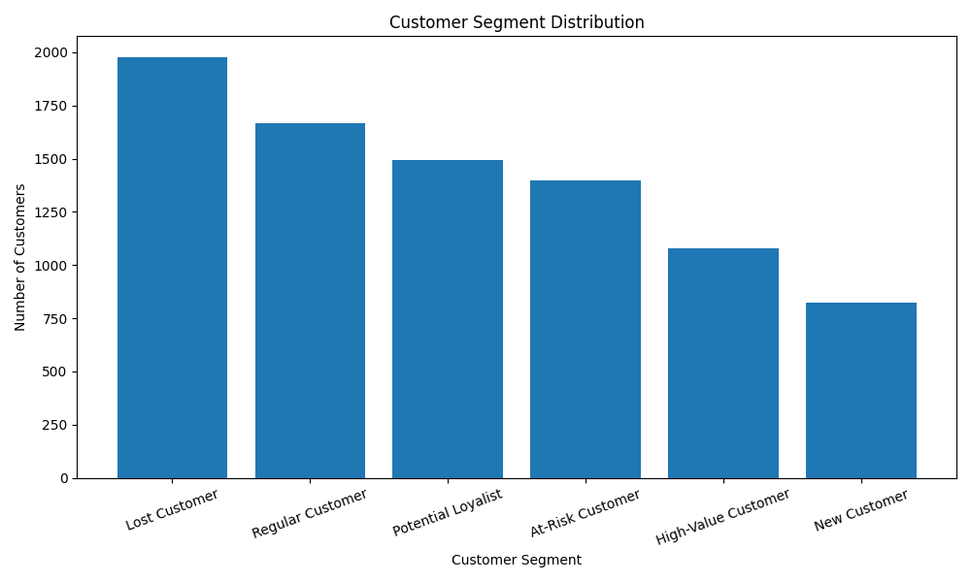
Customer Segmentation (RFM Analysis)
Customer segments and retention insights

Slide 10
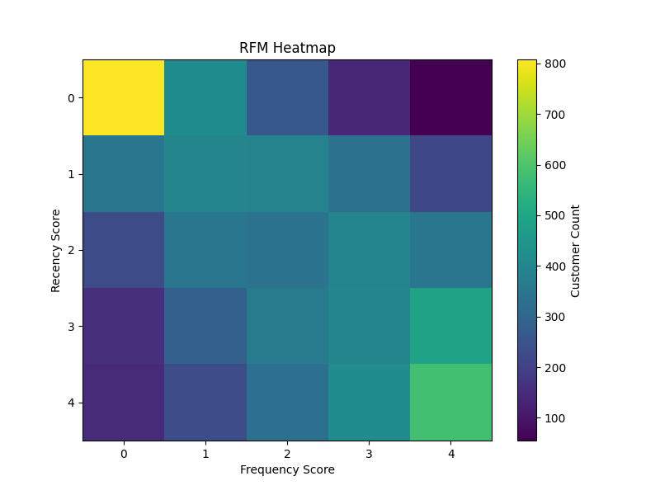
RFM Visualization Insights
Customer behavior and spending patterns

Slide 11
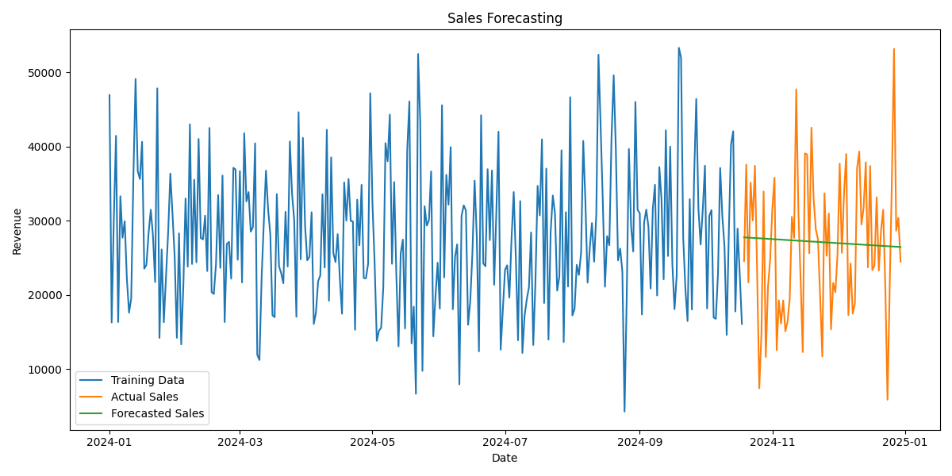
Sales Forecasting
Future sales prediction and forecasting trends

Slide 12
Business Opportunities
Growth opportunities and expansion strategies

Slide 13
Business Recommendations
Inventory optimization
Loyalty programs
Regional marketing
Forecast-based planning
Personalized promotional strategies

Slide 14
Conclusion
Sales trends analyzed
Customer insights generated
Forecasting completed
Business recommendations provided
Business growth opportunities identified

Slide 15
Thank You
Questions & Discussion

